Slide 1
Soft Prompting (COntext OPtimization for Vision-Lang Model)
CoOp, CoCoOp reimplementation
Extension to VQA

Slide 2
Table of Contents
Background
Methods
Experiments
Reimplementation: Image Classification
Extension: VQA

Slide 3
Background

Slide 4
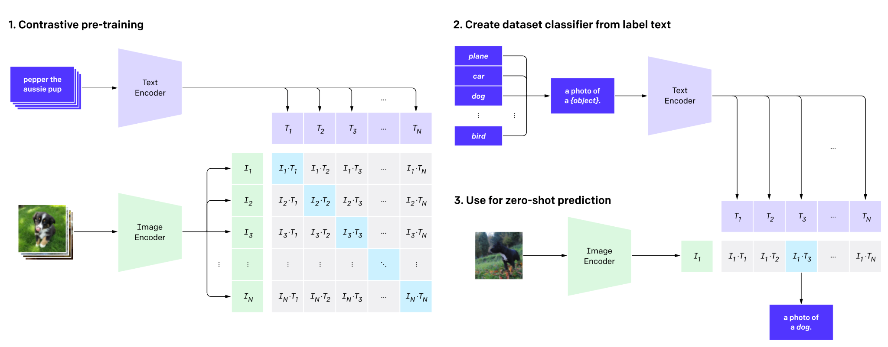
CLIP - Contrastive Language-Image Pre-training
Vision-language pre-training aligns images and texts in a common feature space
Use Prompts to predict
Why use clip for visual tasks: categories often have a textual form, such as “goldfish” or “toilet paper,” they will be converted into discrete labels just for easing the computation of the cross-entropy loss, leaving the semantics encapsulated in texts largely unexploited.

Slide 5
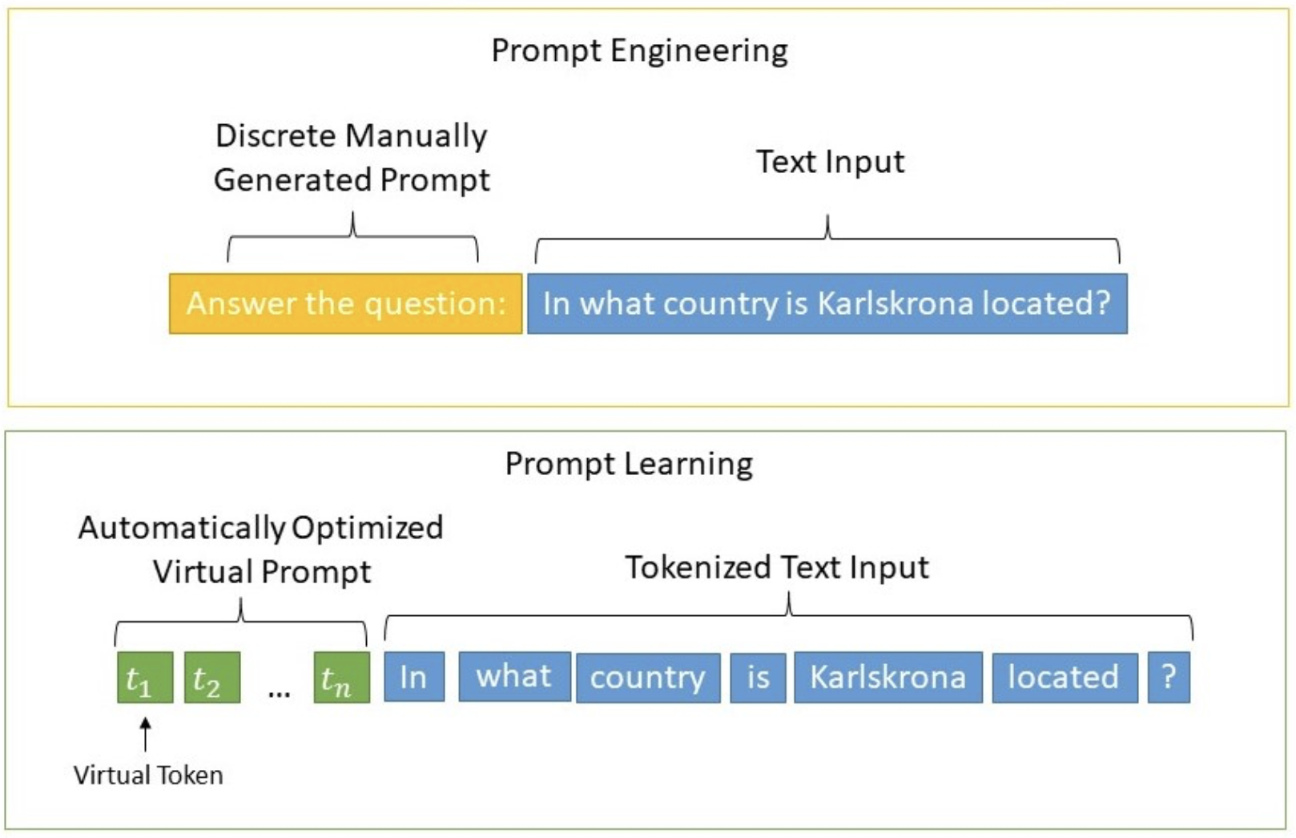
Prompt Learning
Hard Prompt
Soft Prompt
Credits

Slide 6
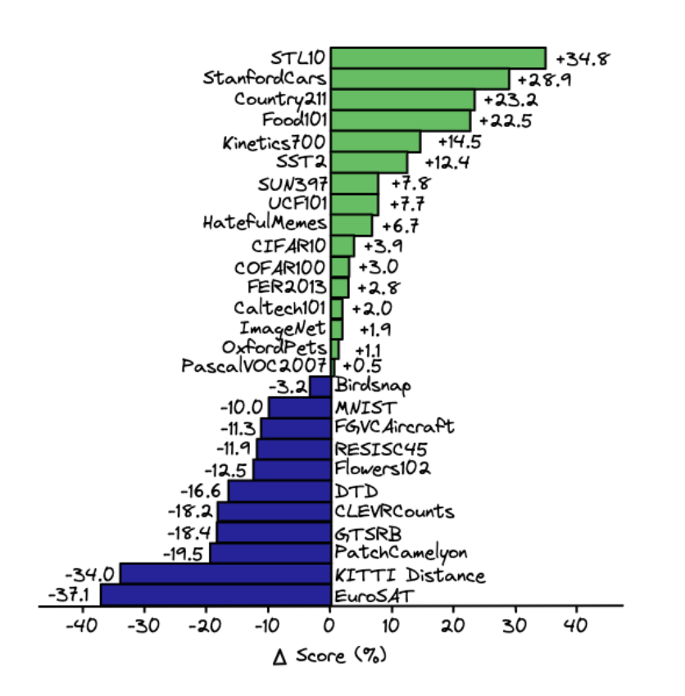
Why use Soft Prompting?
Prompt Engineering is hard!
For CLIP, the text input - prompt, plays a key role in downstream datasets.
CLIP performs poorly on some downstream classifications.
Automatically learn prompts via gradient descent
CLIP Zero Shot performance

Slide 7
Our Project
Vision-Language Models:
CLIP
ALIGN
Prompt Learning:
Knowledge Probing
Continuous Optimization
CoOp
Notes:
learn generic visual representations and allowing zero-shot transfer to a variety of downstream classification tasks via prompting

Slide 8
Methods

Slide 9
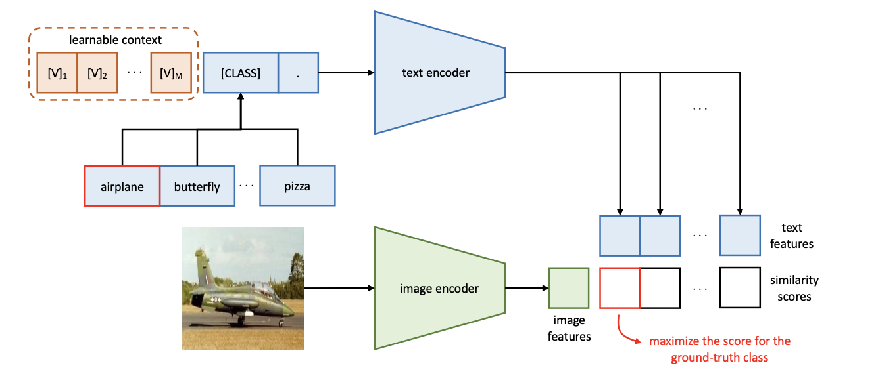
CoOp (Context Optimization)
Aim: Automate prompt engineering, specifically for pre-trained vision-language models.
Model a prompt’s context words with learnable vectors, which could be initialized with either random values or pre-trained word embeddings
Train
Gradients are back-propagated via text encoder
Helps distil rich knowledge for learning task-relevant context.

Slide 10
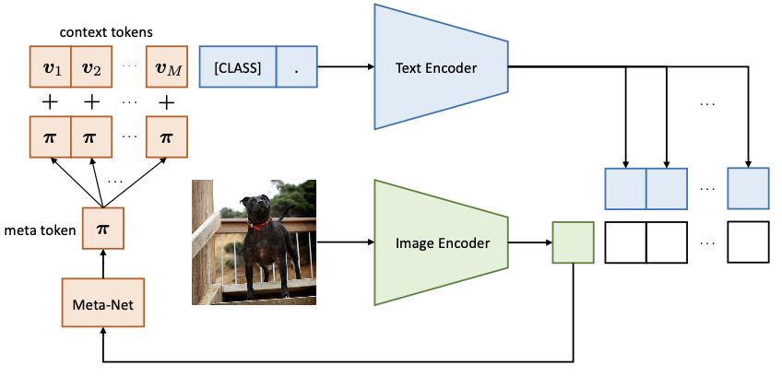
CoCoOp (Conditional CoOp)
Aim: Address critical problem of CoOp: learned context is not generalizable to wider unseen classes within the same dataset. [suggesting that CoOp overfits base classes observed during training]
Idea
Learn a lightweight neural network to generate for each image an input-conditional token (vector).
Optimized to characterize each instance (more robust to class shift) rather than to serve only for some specific classes.

Slide 11
Experiments

Slide 12
Image Classification
Reimplementation

Slide 13
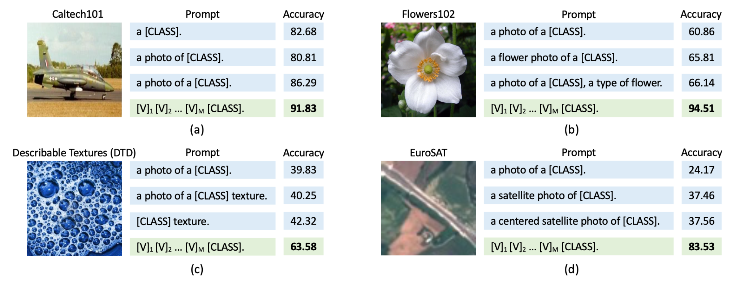
Process
Unified Context: shares the same context with all classes
t = [V]₁ [V]₂ . . . [V]_{M} [CLASS], (2)
where each [V]_{m} (m ∈ {1,...,M}) is a vector with the same dimension as word embeddings
Original CoOp paper results
ZeroShot
CoOp

Slide 14
Experiments
Baselines:
Zero-Shot (CLIP)
Linear Probe (CLIP + Logistic Classifier)
Models
CoOp:
CLIP + Context
CoCoOp:
CLIP + (Image conditioned Context)
Experiments
Performance on 4 datasets
Different context size
Different CLIP base models
Generalisation power
Performance on unseen classes

Slide 15
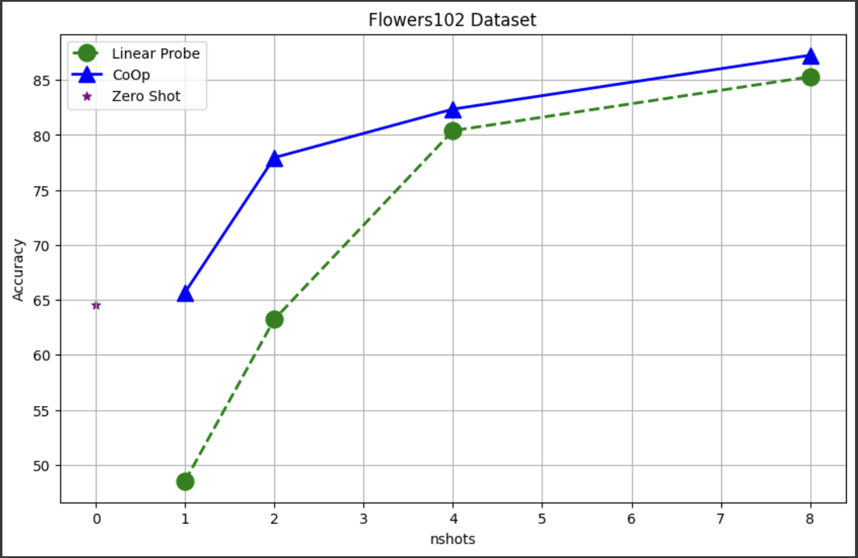
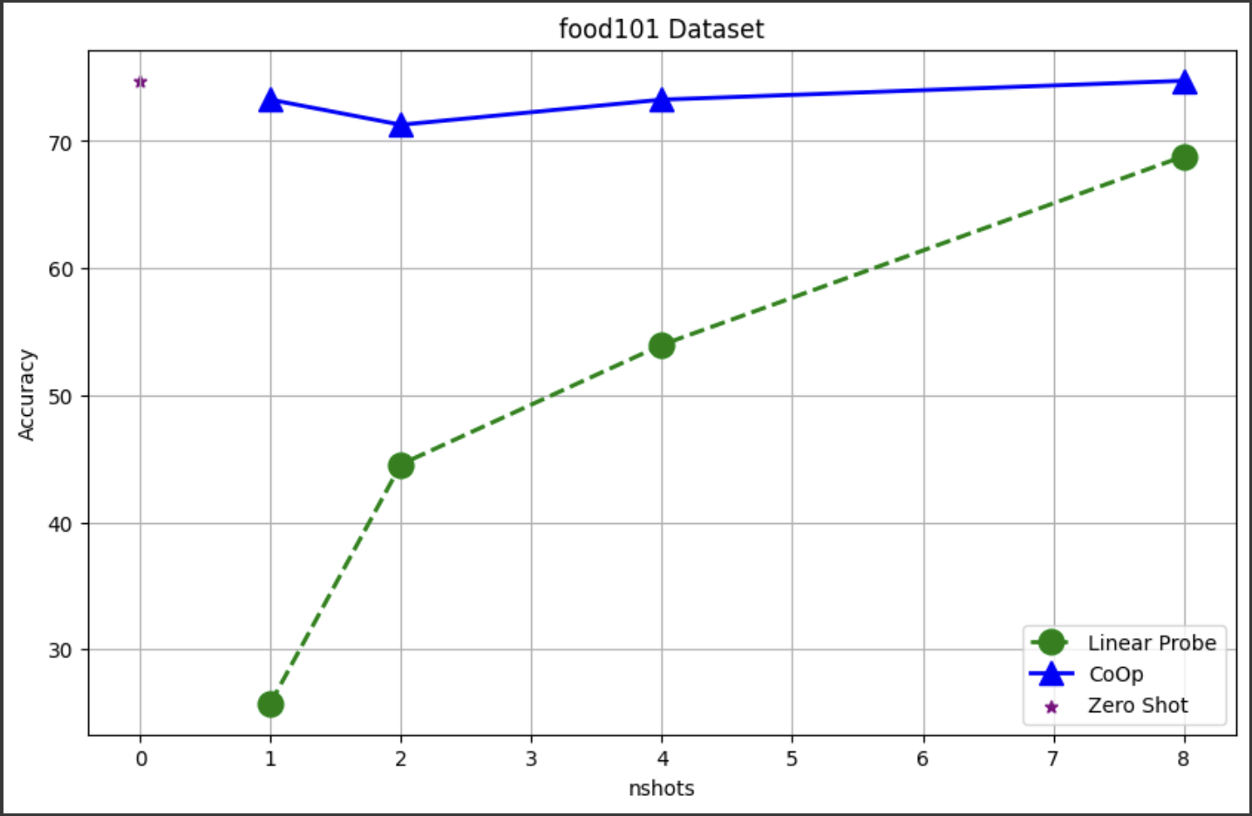
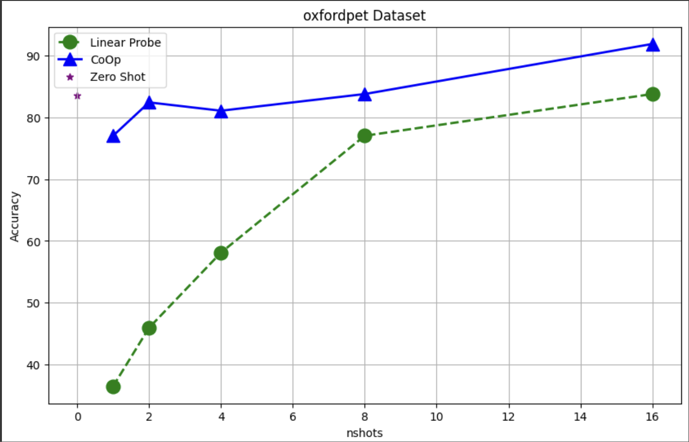
Results: Baselines + CoOp
Fine Grained Datasets
Learnable context
Global prompt
Position: End of the prompt
Context size = 16
Random normal initialisation
Other Parameters:
CLIP Base model RN50
Optimizer: SGD, LR: 1e-3
OxfordFlowers Dataset - 102 Categories
Food Dataset - 101 Categories
OxfordPet Dataset - 37 Categories

Slide 16

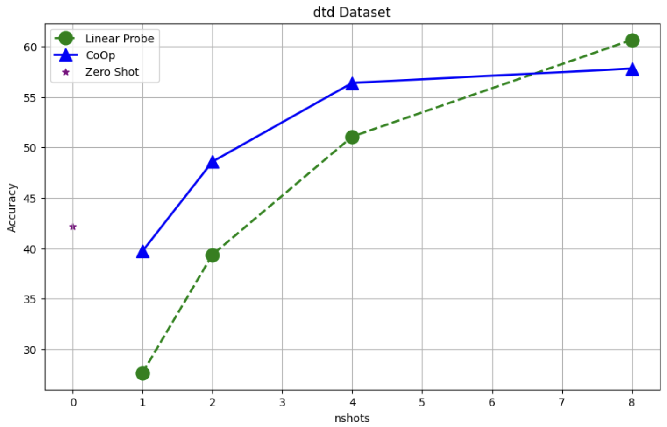
Specialized task
Describable Textures Dataset
Dataset with 47 categories
Generally difficult to classify using Pre-trained models
Needs engineered prompt for better performance

Slide 17
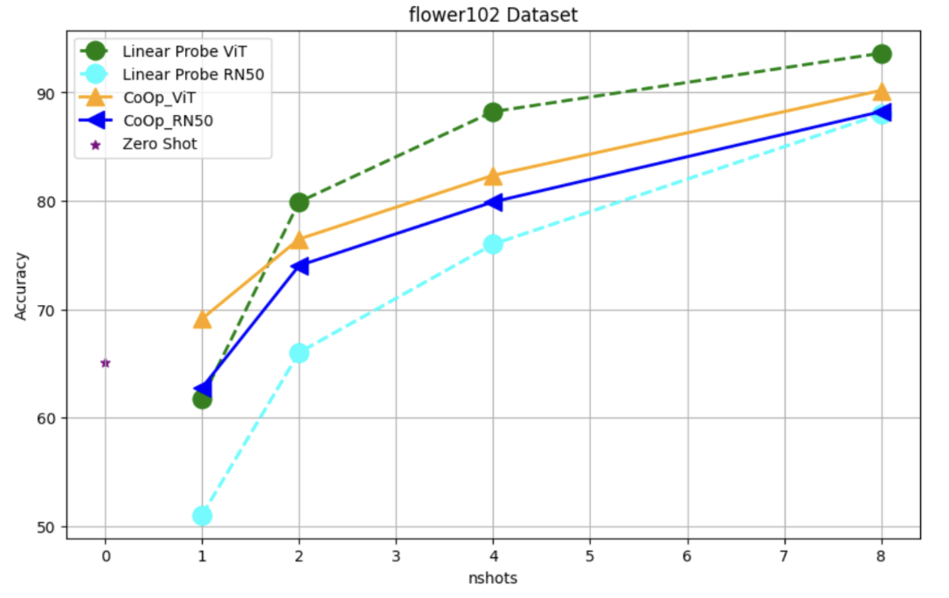
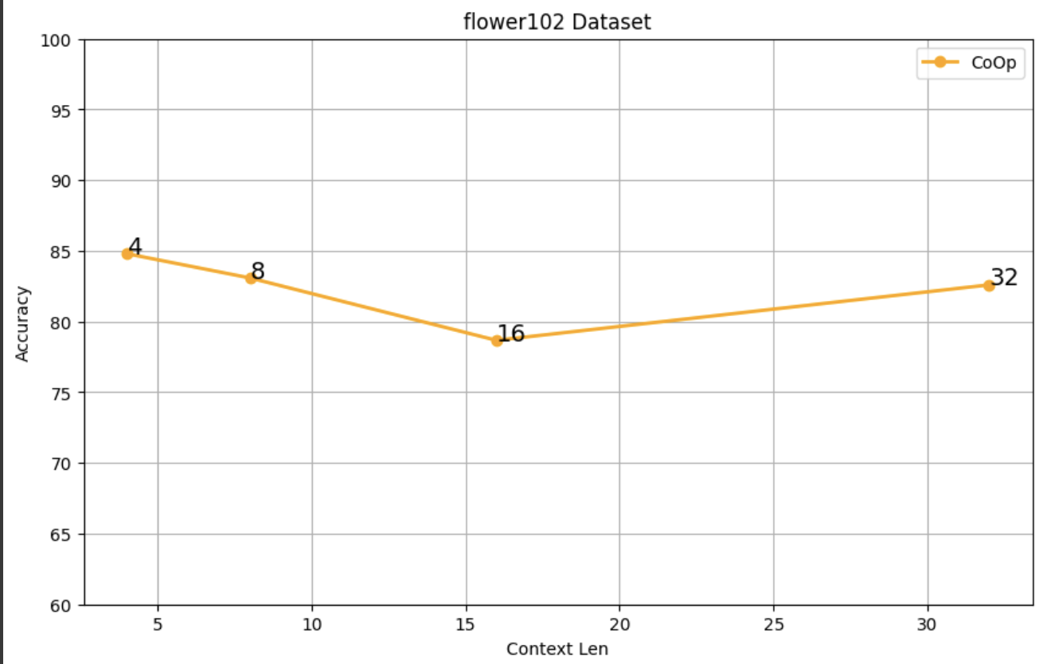
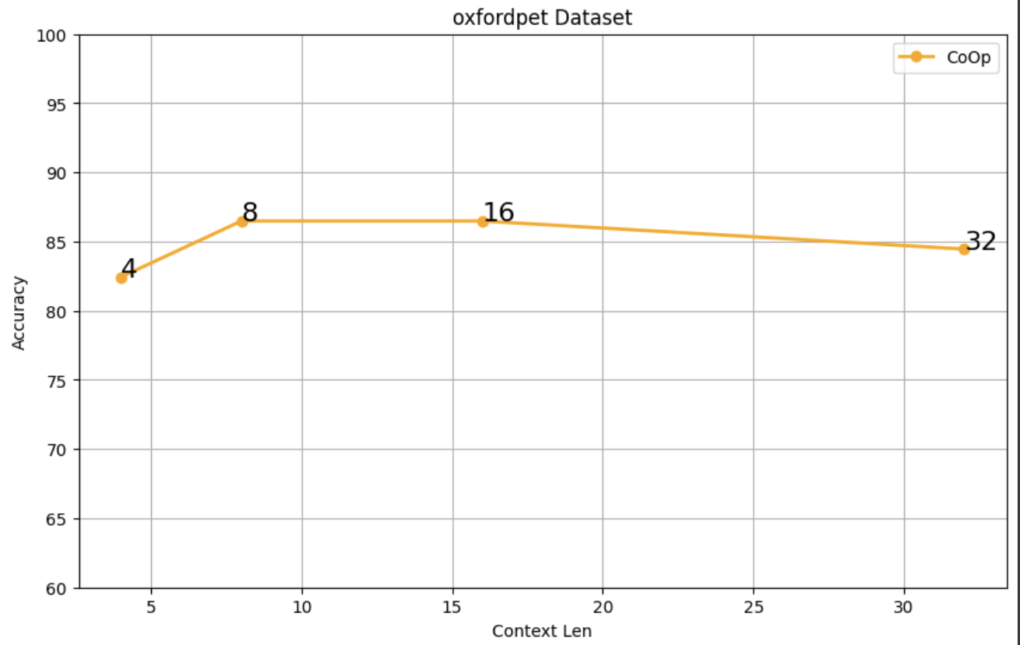
Advanced backbones perform better
Comparing RN50 vs ViT32
Improved performance when using ViT as base CLIP model
Varying Context - size
Change in performance %
More context - better for more classes

Slide 18
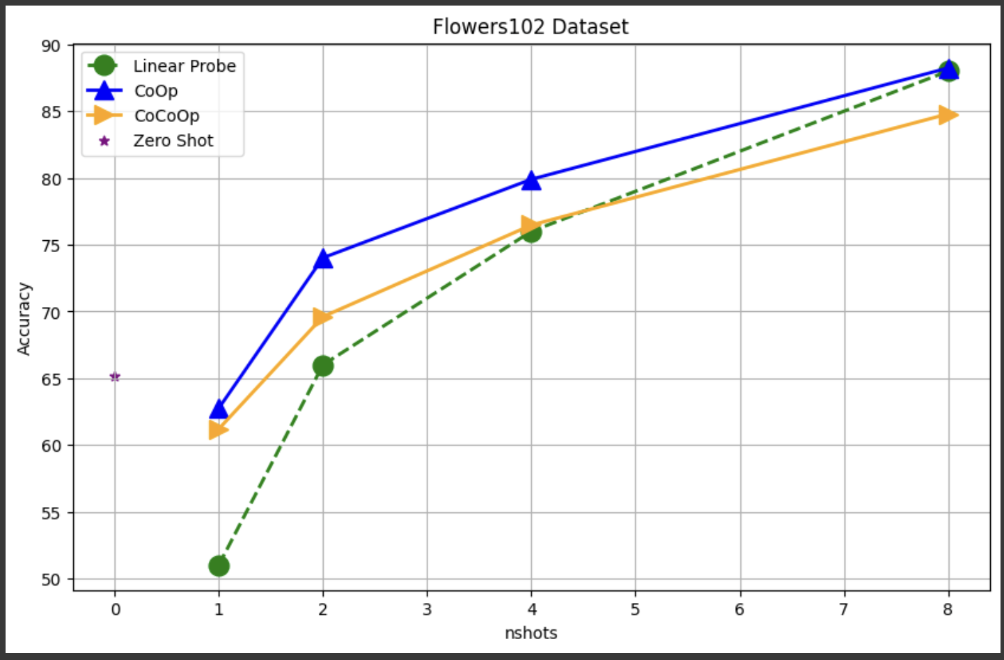
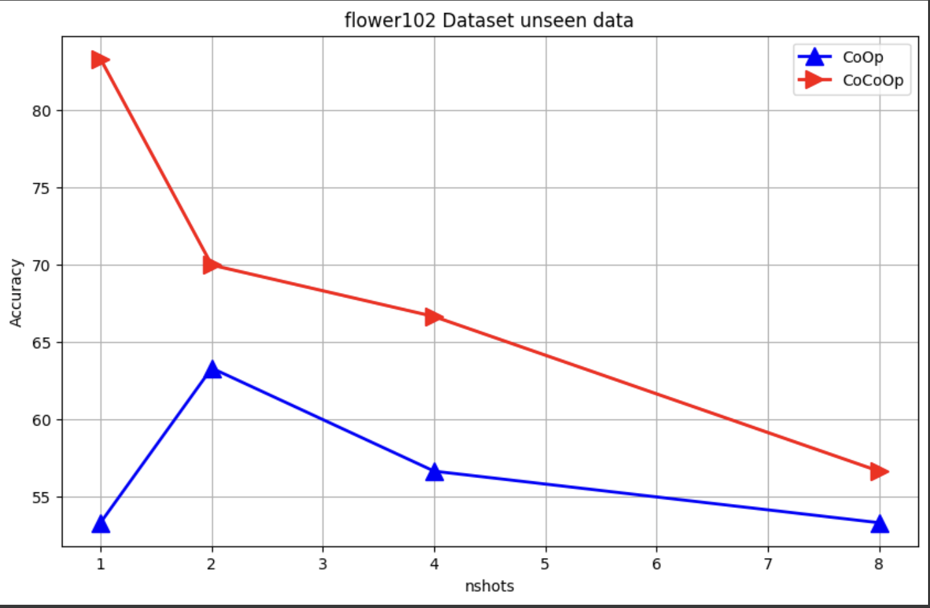
CoOp vs CoCoOp
CoCoOp lags in base classes by ~5%
But this loss in accuracy gives better generalisation power
CoCoOp generalisation power is high
Training on n-x classes and testing on x unseen classes

Slide 19
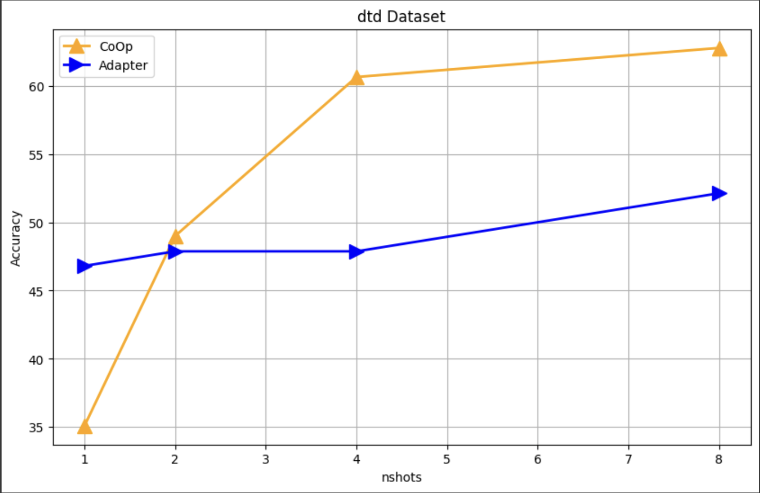
CLIP Adapters
Comparing performance
Using dataset DTD - difficult to classify by CLIP
Keeping all parameters constant (default parameters from GitHub)
Conclusion:
Using Adapters is really efficient - fast to train
But hyper-parameter tuning is tough!

Slide 20
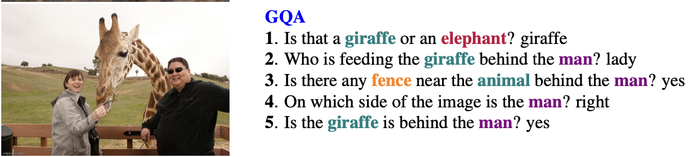
VQA
Extension

Slide 21
Idea
VQA (Visual Question Answering) can be technically considered as a classification problem given a fixed range of answer choices.
Extend CoOp & CoCoOp to VQA by adding the Question tokens in front of the context vectors.
2 versions of CoCoOp for VQA:
Conditioned on image
Conditioned on image + question (could not test this yet due to time and resource limit)

Slide 22
Experiment
Dataset: GQA (Question Answering on Image Scene Graphs)
There are 5 question types and only 2 of which have constrained range of classes: Verify & Logical
Randomly select 1000 samples from each type
Baselines:
CLIP 0-shot (text = question + answer, no prompt engineering)
BLIP-2 0-shot (current SOTA VQA model)
Implementation challenge:
With the addition of question embeddings for each sample, it is not possible to fix the prefix/suffix embeddings of the context vectors beforehand. [Need to do this per batch at each forward step -> potential drop in efficiency?]

Slide 23
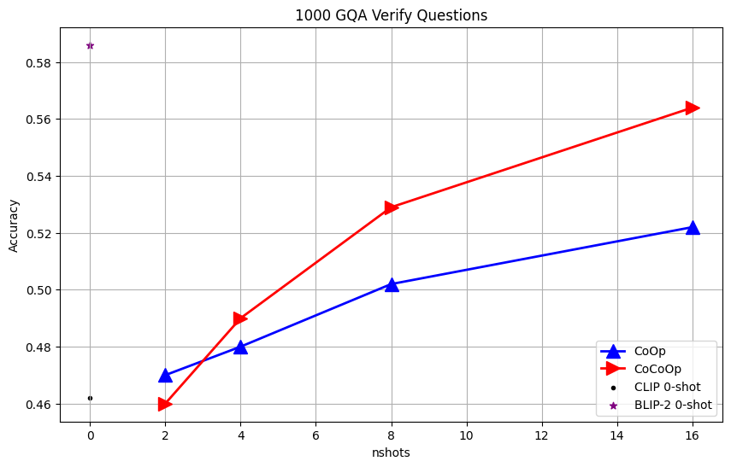
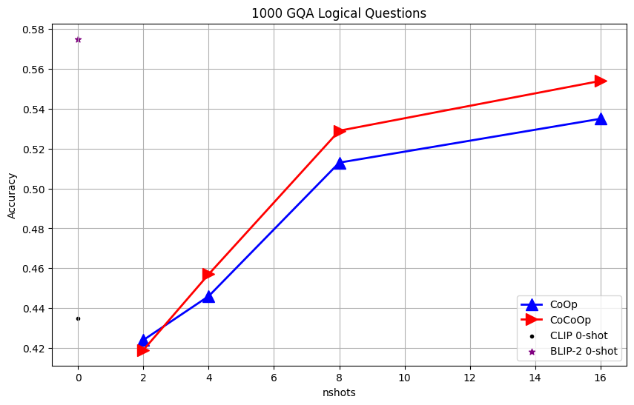
Results
Verify Questions
Logical Questions

Slide 24
Results
CoOp & CoCoOp can be applied to VQA just like image classification.
CoCoOp performs better than CoOp.
Perform
better with more shots in few-shot learning.
worse than CLIP baseline with only 2 shots possibly due to overfitting.
worse than BLIP-2 at the moment, which is expected since the base model CLIP is intrinsically worse than BLIP-2. [Changing the base model to BLIP-2 might lead to a better performance?]

Slide 25
Thank you!

